Slide 1

Steganography Project
Shivam Vatshayan

Slide 2
CONTENT
Introduction
Example
Advantage
Disadvantage
Techniques
Image Steganography
Proposed Model
References

Slide 3
INTRODUCTION
Steganography is the technique of hiding secret data within an ordinary, non-secret, file or message in order to avoid detection; the secret data is then extracted at its destination.
The use of steganography can be combined with encryption as an extra step for hiding or protecting data.
The word steganography is derived from the Greek words steganos (meaning hidden or covered) and the Greek root graph (meaning to write)

Slide 4
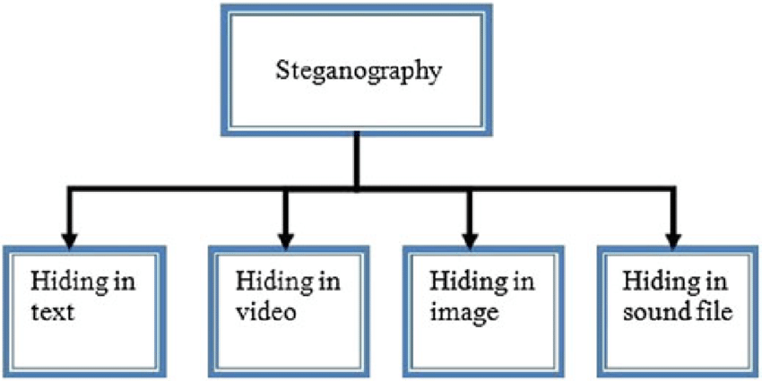
PICTORIAL REPRESENTATION

Slide 5
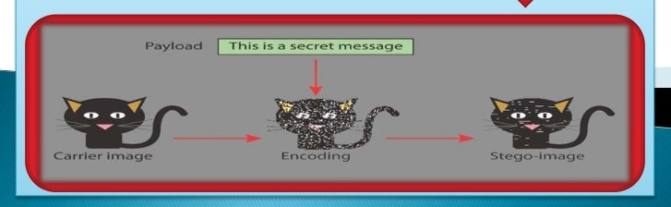
EXAMPLE
There are many ways to conceal information using Steganography. The most common method is by embedding information into digital images.
We all know that digital images say, a JPEG image, contains several megabytes of data in the form of pixels.

Slide 6
ADVANTAGES
Difficult to Detect
Only Receiver can Detect
It can done faster through large no. of softwares
Important communication exchange
Provides better security through LAN, MAN, WAN
Can be applied differently with audio, video and Image.
Hide data over encryption is that it helps obscure the fact that there is sensitive data hidden in the file or other content carrying the hidden text.

Slide 7
DISADVANTAGES
Only Small size of photos can conceal
Breaking down of software or server can replicate the Data
Suspicious Activity Inclusion
Invalidate Signatures
Invalidate Hashing

Slide 8
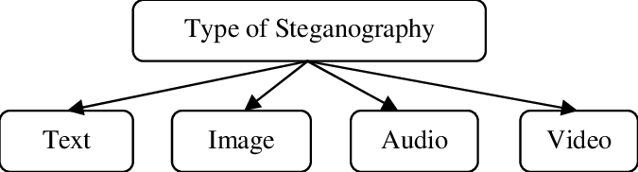
STEGANOGRAPHY TECHNIQUES
Text Steganography
Image Steganography
Video Steganography
Audio Steganography
Network Steganography

Slide 9
IMAGE STEGANOGRAPHY
Hiding the data by taking the cover object as the image is known as image steganography. In digital steganography, images are widely used cover source because there are a huge number of bits present in the digital representation of an image. There are a lot of ways to hide information inside an image.
Least Significant Bit Insertion
Masking and Filtering
Redundant Pattern Encoding

Slide 10
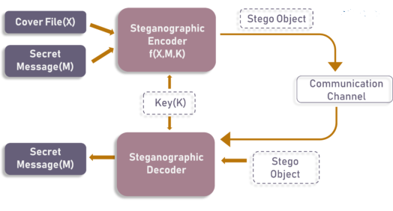
PROPOSED MODEL

Slide 11
CONCLUSION
This Software will be Harder and more complex
Any Shape and Size Image will Hide and Carry Message
Less Data Reduction
Image Communication with less time and space complexity
Active and passive attacks will not easily able to break down the system

Slide 12
REFERENCES
https://en.wikipedia.org/wiki/Steganography
https://www.ukessays.com/essays/computer-science/the-types-and-techniques-of-steganography-computer-science-essay.php
https://www.ques10.com/p/33259/explain-steganography-and-its-types/
https://searchsecurity.techtarget.com/definition/steganography#:~:text=Steganography%20is%20the%20technique%20of,for%20hiding%20or%20protecting%20data.
https://www.spiedigitallibrary.org/conference-proceedings-of-spie/6074/60740G/Wireless-steganography/10.1117/12.650263.short?SSO=1

Slide 13
IMPORTANT
You can use this Project for your College project, School work and Office.
I will Send you PPT, Project Code, Research papers and Report that are made on this Project
New and Updated project.
Mail me Vatshayan007@gmail.com Now to get this Full project ASAP.
Shivam Vatshayan
Software Engineer
B.tech CSE

